Slide 1
OKE + Oracle Logging
Flexibilidade e Poder para a Observabilidade
Cristiano Hoshikawa
Senior Cloud Engineer
crisrtiano.hoshikawa@oracle.com

Slide 2
Safe harbor statement
The following is intended to outline our general product direction. It is intended for information purposes only, and may not be incorporated into any contract. It is not a commitment to deliver any material, code, or functionality, and should not be relied upon in making purchasing decisions.
The development, release, timing, and pricing of any features or functionality described for Oracle’s products may change and remains at the sole discretion of Oracle Corporation.

Slide 3

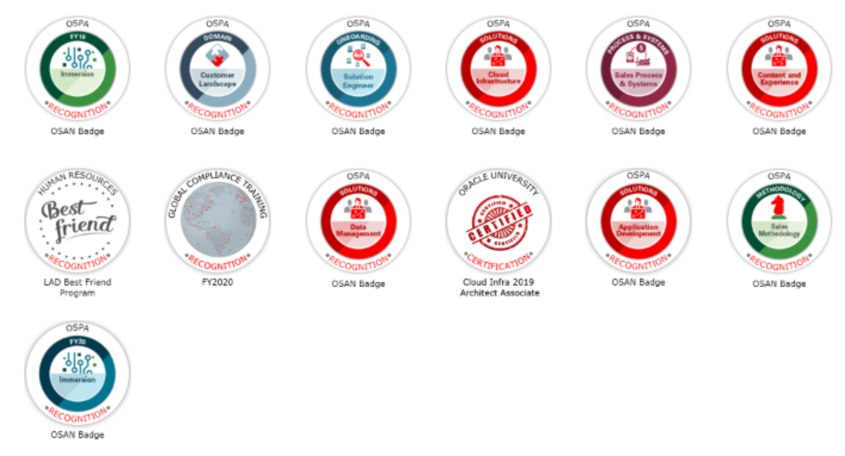



$> whoami
+25 years on IT Market
2.5 years Working in Oracle Brazil
Solution Eng. Sales Consultant
LAD Team
DevOps, Cloud Native, Integration, Mobile and CRM specialist
The Redwoods
Cristiano Hoshikawa
Cloud Solution Engineering
Oracle Cloud Team
cristiano.hoshikawa@oracle.com
https://www.linkedin.com/in/cristianohoshikawa/
https://github.com/hoshikawa2

Slide 4


Porquê existe o caos?
DEV

Slide 5

Será que existe solução?
DEV

Slide 6

O mundo poderia ser melhor?
DEV

Slide 7


Oracle Cloud Infrastructure Services
OCI BRAZIL
DNS
WAF
Availability Domain
API Gateway
Apiary
APM
Image
Repository
Kubernetes
Customer
Datacenter
ERP
Cloud and
On-prem
Integration
Process Builder
Workflows BPMN2.0
CRM
Git
Repository
Serverless
1 GBs
FastConnect
BUS Service
/ SOA
Legacy
BUS Service / SOA
On-Premises
Dynamic Routing Gateway
DevOps
Logging
Oracle SaaS
HCM, ERP Cloud, Cx, Responsys
Bancos
SQL
NoSQL
LOWCODE
APP
Development
Analytics
Kafka
Streaming
Equinix/Ascenty
Other
Clouds
7
Copyright © 2020, Oracle and/or its affiliates
3rd part
SaaS

Slide 8
Logging para o micro-serviço de Consulta a CEP
OCI BRAZIL
DNS
WAF
Availability Domain
API Gateway
Apiary
APM
Image
Repository
Kubernetes
Customer
Datacenter
ERP
Cloud and
On-prem
Integration
Process Builder
Workflows BPMN2.0
CRM
Git
Repository
Serverless
1 GBs
FastConnect
BUS Service
/ SOA
Legacy
BUS Service / SOA
On-Premises
Dynamic Routing Gateway
DevOps
Logging
Oracle SaaS
HCM, ERP Cloud, Cx, Responsys
Bancos
SQL
NoSQL
LOWCODE
APP
Development
Analytics
Kafka
Streaming
Equinix/Ascenty
Other
Clouds
8
Copyright © 2020, Oracle and/or its affiliates
CEP Service

Slide 9
Container Engine for Kubernetes - OKE
O que é?
Serviço gerenciado de contêineres Kubernetes para implantar e executar seus próprios aplicativos baseados em contêiner
Ferramentas para criar, dimensionar, gerenciar e controlar seus próprios clusters padrão Kubernetes instantaneamente
Que problemas resolve?
Muito complexo, caro e demorado para construir e manter ambientes
É muito difícil integrar o Kubernetes com um registro e um processo de criação para o gerenciamento do ciclo de vida do contêiner
Muito difícil de gerenciar e controlar o acesso da equipe aos clusters de produção
Benefícios
Permite aos desenvolvedores começar e implantar contêineres rapidamente. Dá visibilidade e controle às equipes de DevOps para o gerenciamento do Kubernetes.
Combina a orquestração de contêineres de nível de produção de Kubernetes abertos, com controle, segurança, IAM e desempenho altamente previsível da infraestrutura em nuvem da próxima geração da Oracle
Confidential – Oracle Internal
9

Slide 10
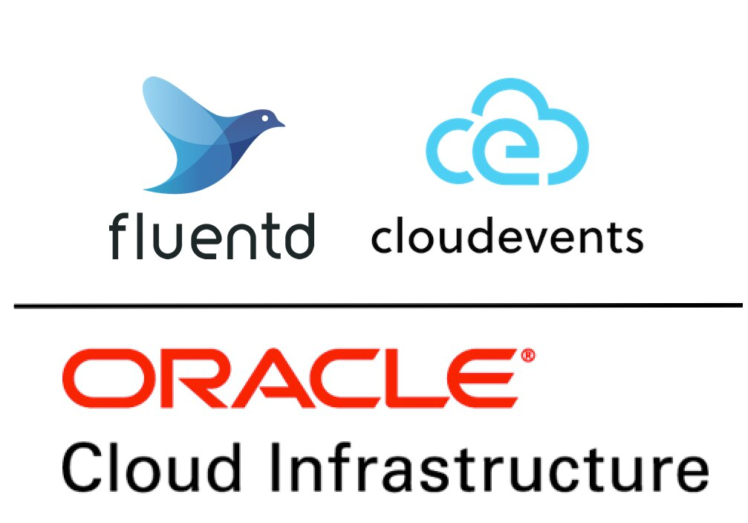
Oracle Logging
O que é?
Serviço gerenciado para ingestão de logs de infraestrutura para todos os recursos da Oracle Cloud Infrastructure (OCI)
Permite a ingestão, pesquisa, integração e manutenção dos logs de forma segura e centralizada
Que problemas resolve?
Logs sem padronização
Ingestão de Logs descentralizados
Acesso a Informações sensíveis
Benefícios
Totalmente integrado com os recursos Oracle Cloud como OKE, functions, API Gateway, Compute, VCN; além de permitir integração com recursos on-prem e multi-cloud
Utilização de padrões abertos como Fluentd, Kafka, Cloudevents, Splunk
Segurança e Confidencialidade
Permite buscar por todos os Logs de forma flexível e centralizada

Slide 11
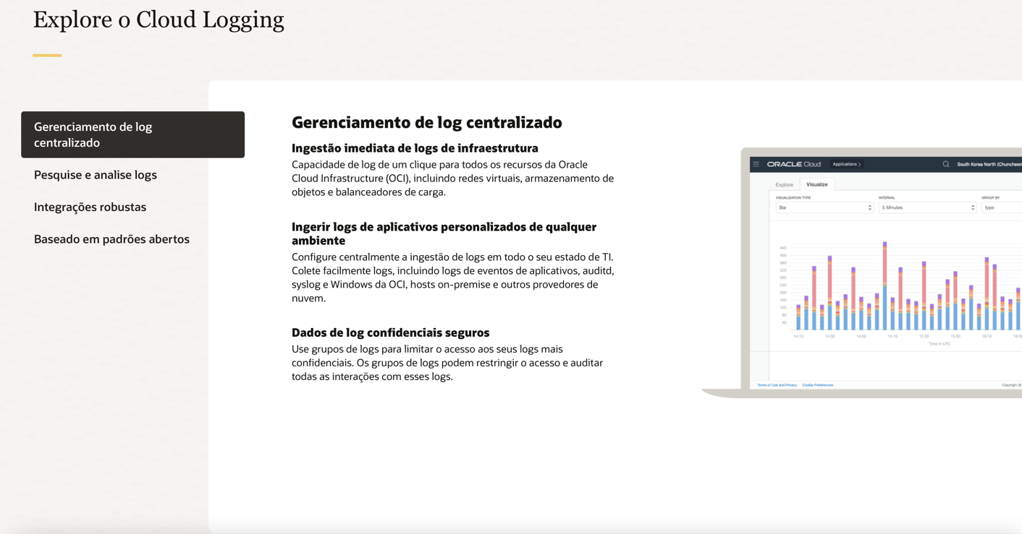
Tirar os prints das telas do site
https://www.oracle.com/br/devops/logging/

Slide 12
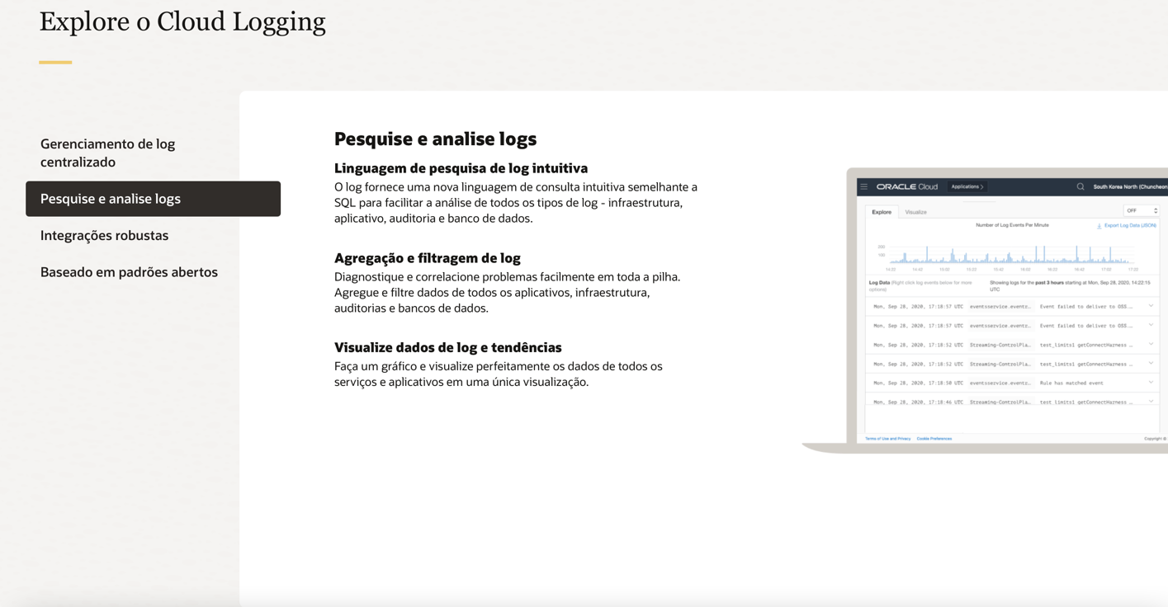
Tirar os prints das telas do site
https://www.oracle.com/br/devops/logging/

Slide 13
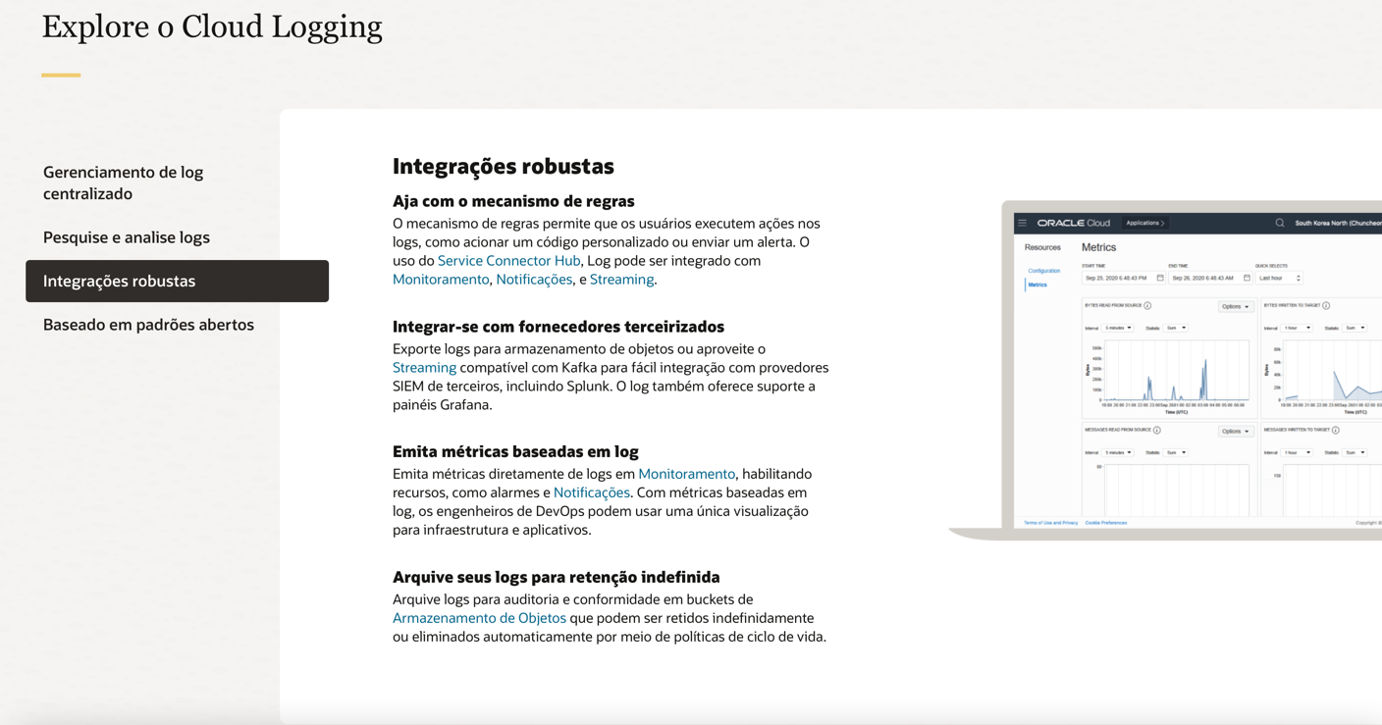

Slide 14
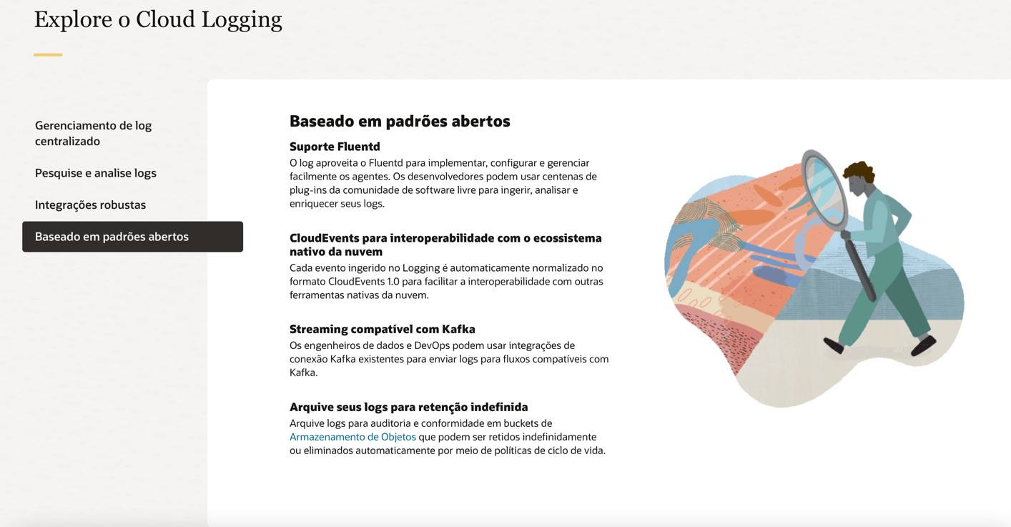

Slide 15
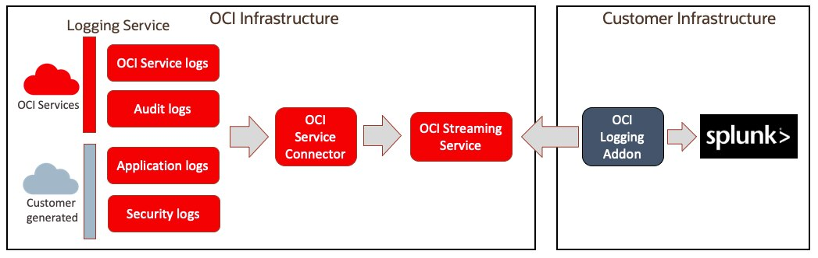
Oracle Cloud Logging integrado com ferramentas de mercado

Slide 16
Demo-Live: OKE Logging

Slide 17
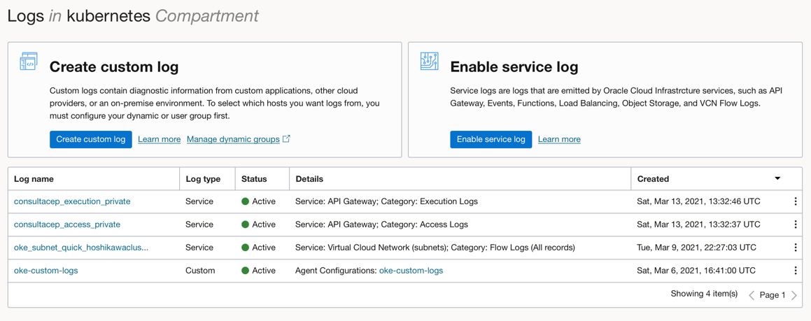
Centralização da Ingestão de Logs

Slide 18
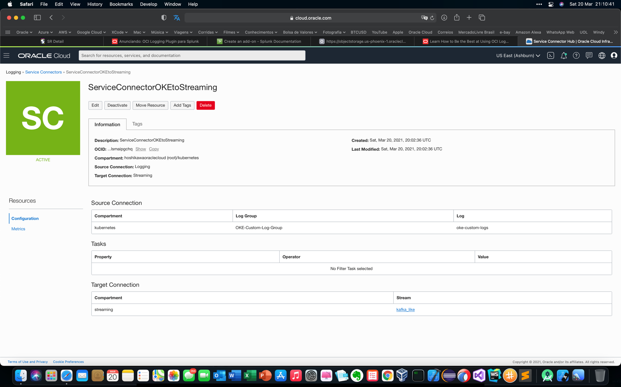
Service Connector Hub
Permite automatizar a integração
dos Logs para serviços como:
Oracle Object Storage
Oracle Streaming
Monitoring
Functions
Notifications
https://blogs.oracle.com/cloud-infrastructure/announcing-integration-of-service-connector-hub-with-logging-analytics

Slide 19
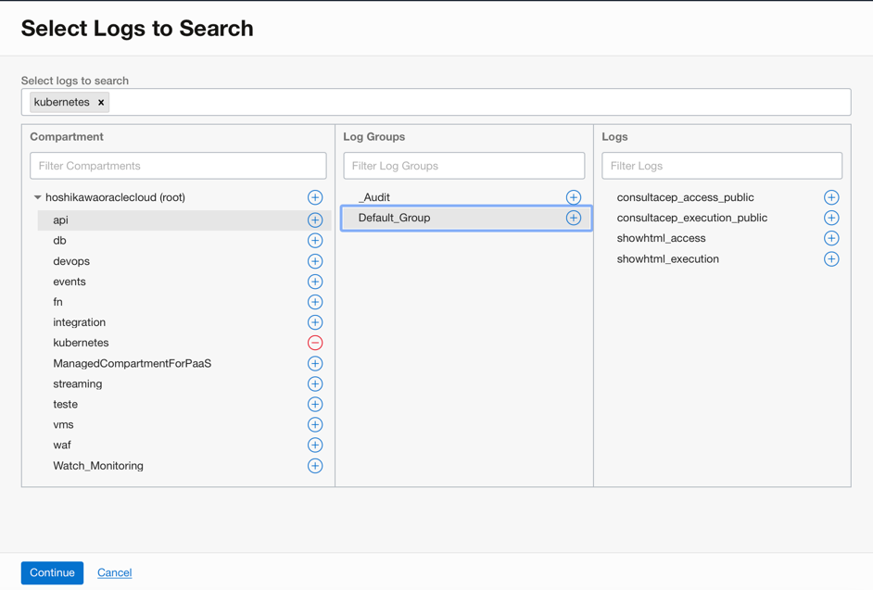
Log Search
Permite estabelecer critérios de busca para todos
os Logs

Slide 20
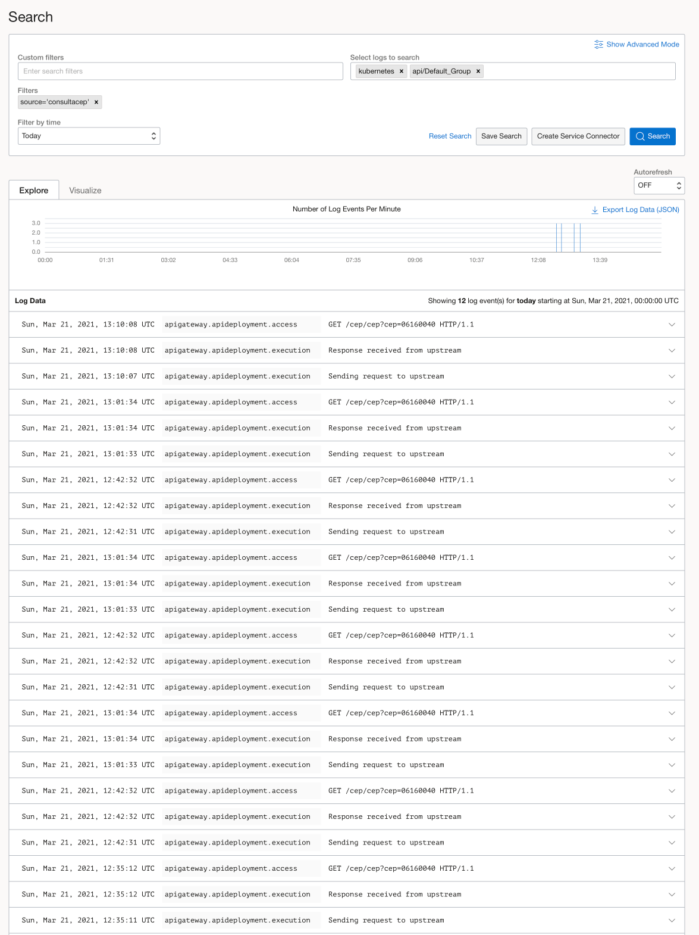
Log Search
Permite estabelecer critérios de busca para todos
os Logs

Slide 21
Links Interessantes
Oracle Logging
https://www.oracle.com/br/devops/logging/
Tutorial
https://www.ateam-oracle.com/observabitiliy-on-oracle-oci-using-custom-logs-in-oci-logging-to-monitor-and-analyze-cloud-native-applications
Documentação (API REST, ...)
https://docs.oracle.com/en-us/iaas/Content/Logging/Concepts/loggingoverview.htm
Service Connector Hub
https://docs.oracle.com/en-us/iaas/Content/service-connector-hub/overview.htm
https://blogs.oracle.com/cloud-infrastructure/announcing-integration-of-service-connector-hub-with-logging-analytics

Slide 22
Links Interessantes
Oracle Container for Kubernetes (OKE)
https://www.oracle.com/br/cloud-native/container-engine-kubernetes/
Oracle Cloud Application Performance Monitoring
https://blogs.oracle.com/cloud-infrastructure/announcing-the-oracle-cloud-observability-and-management-platform
Configure Application Performance Monitoring Data Sources
https://docs.oracle.com/en-us/iaas/application-performance-monitoring/doc/configure-application-performance-monitoring-data-sources.html
Deploy the APM Browser Agent With Your Application
https://docs.oracle.com/en-us/iaas/application-performance-monitoring/doc/deploy-browser-agent-your-application.html#GUID-4EFE2DA6-2D91-4150-B1BF-48B61C399830

Slide 23
Links Interessantes
SPLUNK
https://www.splunk.com/en_us/blog/tag/open-source.html
https://www.reddit.com/r/Splunk/comments/f7athg/setting_up_splunk_in_a_local_k8s_cluster/
https://www.splunk.com/en_us/blog/it/an-insider-s-guide-to-splunk-on-containers-and-kubernetes.html
https://github.com/splunk/docker-splunk/tree/develop/test_scenarios/kubernetes
Install Splunk on OKE
https://www.reddit.com/r/Splunk/comments/f7athg/setting_up_splunk_in_a_local_k8s_cluster/
OCI Logging plugin Splunk
https://blogs.oracle.com/cloud-infrastructure/announcing-the-oracle-cloud-infrastructure-logging-plugin-for-splunk
Getting data from your REST APIs into Splunk
https://www.splunk.com/en_us/blog/tips-and-tricks/getting-data-from-your-rest-apis-into-splunk.html

